Slide 1

WELCOME TO MY CLASS
English 9

Slide 2
UNIT 3: A TRIP TO THE COUNTRYSIDE
Lesson 2: + Speak ( P. 24 )
+ Listen ( P. 25 )
I. Speak: Asking for and giving information
+ New words
+ Making questions
+ Asking-answering questions about villages
II. Listen: Listening for specific information
+ Vocabulary
river
+ Listen and Match
+ Listen and Fill in the blanks
+ Listen and Correct mistakes
III. Homework

Slide 3
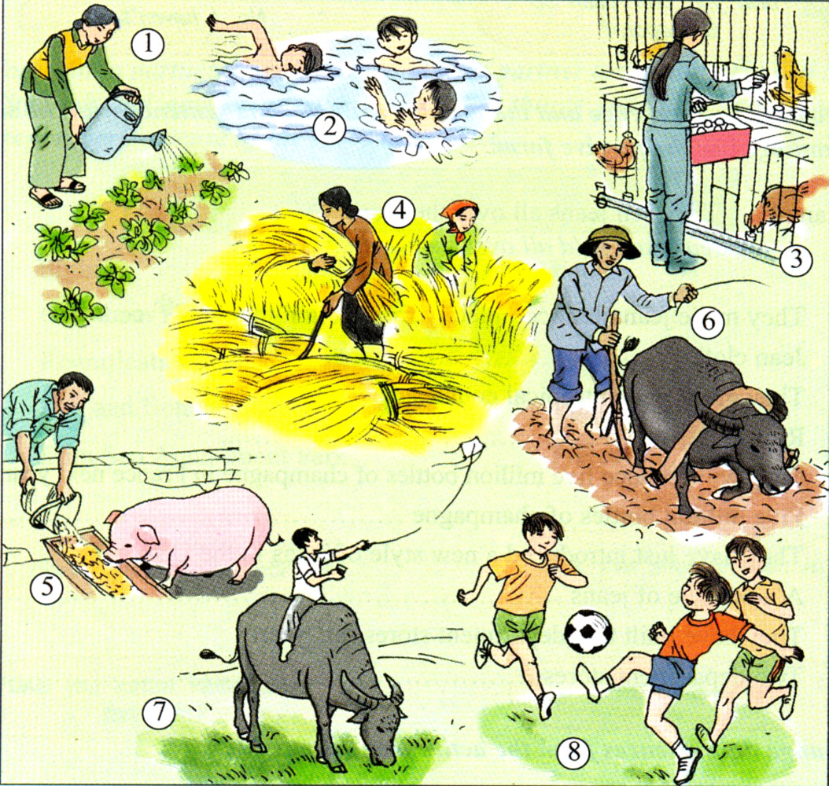
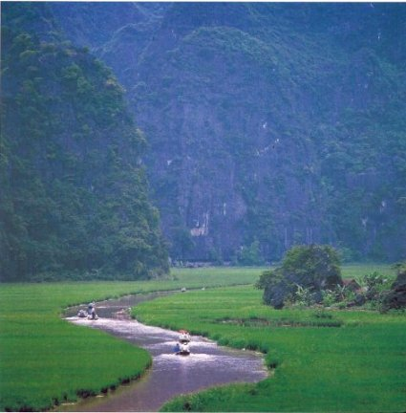
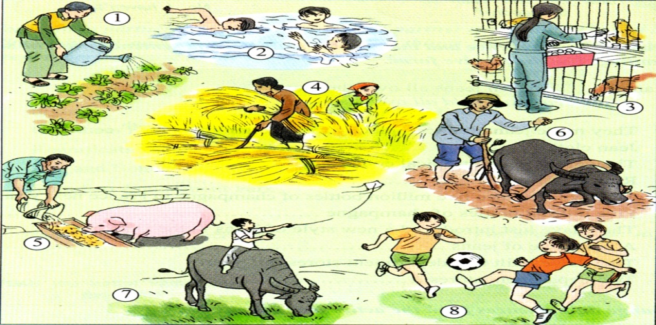
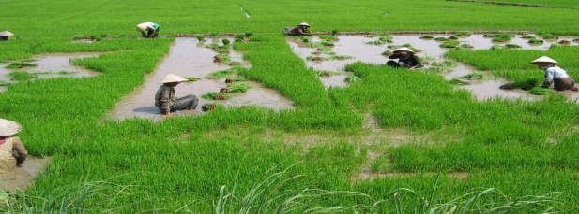
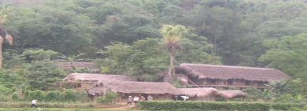
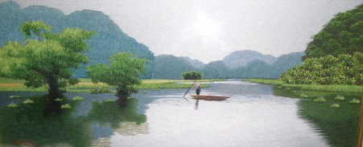
New words:
- do (sth) for a living
→ làm việc gì đó để sinh sống
- raise cattle
→ nuôi gia súc
Eg: What do people in Ba’s village do for a living?
→ They plant rice and raise cattle
River
Eg: People in my village plant rice and vegetables for a living.
my village.
Eg: People in Ba’s village plant rice and raise cattle for a living.
raise cattle
Ba’s village.

Slide 4
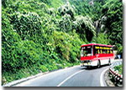
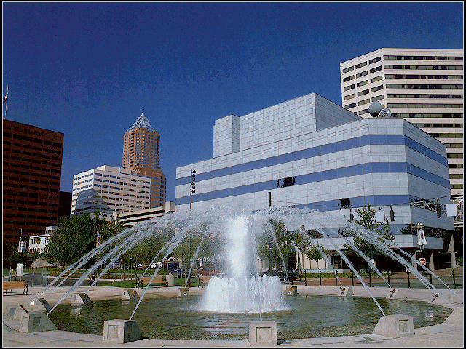
I. Speak: Asking for and giving information
( P. 24 )
TASK 1: Making questions
Use the words in the box to make any questions about the trip to Lan’s village (2 minutes )
Where, How far, How, How long, What, Do/Does
This is the city where Lan has lived.
about 30 km
about 1 hour
River
to the south of the city
river
river
Eg: Where does Lan live?
Where is Lan’s village?
Does Lan live in the city/village?
Lan’s village.

Slide 5
Tell your friends some questions you have made
Check if you have made any same questions
1. Where is Lan’s home village?
2. How far is it from the city?
3. How can Lan get there?
4. How long does it take to get there?
5. What do people do for a living in Lan’s village?
river
6. Does Lan’s village have a river?

Slide 6
I. Speak: Asking for and giving information
+ Asking-answering questions about villages
TASK 2: Pair work: Look at the picture with the information on it to ask and answer about Lan’s village
river

Slide 7
TASK 2: Pair work: Look at the picture with the information on it
to ask and answer about Lan’s village
1. Where is Lan’s home village?
This is the city where Lan has lived.
→It’s to the south of the city.
2. How far is it from the city?
→It’s about 30 kilometers from the city.
3. How can Lan get there?
→She can get there by bus.
4. How long does it take her to get there?
→It takes her about 1 hour to get there.
about 30 km
5. What do people do for a living in Lan’s village?
about 1 hour
to the south of the city
River
→They plant rice and vegetables.
river
river
6. Does Lan’s village have a river?
→Yes , it does. (There is a river flowing across the village.)
Lan’s village.

Slide 8
I. Speak: Asking for and giving information
+ Asking-answering questions about villages
TASK 2: Pair work: Look at the picture with the information on it to ask and answer about YOUR village
This is the city where YOU have lived.
SITUATION A
about 30 km
about 1 hour
to the south of the city
River
river
river
YOUR village.

Slide 9
TASK 2: Pair work: Look at the picture with the information on it to ask and answer about YOUR VILLAGE
1. Where is YOUR home village?
This is the city where YOU have lived.
→It’s to the south of the city.
2. How far is it from the city?
→It’s about 30 kilometers from the city.
3. How can YOU get there?
→I can get there by bus.
4. How long does it take YOU to get there?
→It takes me about 1 hour to get there.
about 30 km
5. What do people do for a living in YOUR village?
about 1 hour
to the south of the city
River
→They plant rice and vegetables.
river
river
6. Does YOUR village have a river?
→Yes , it does. (There is a river flowing across the village.)
YOUR village.

Slide 10

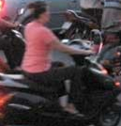



I. Speak: Asking-answering questions about villages
TASK 2: Pair work: Look at the picture with the information on it to ask and answer about YOUR village
This is the city where YOU have lived
SITUATION B
Your village.
to the west of the city
river
about 15 km
about 50 minutes
a big lake

Slide 11
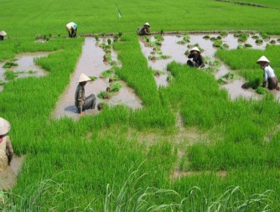


TASK 2: Pair work: Look at the picture with the information on it to ask and answer about YOUR VILLAGE
1. Where is YOUR home village?
This is the city where YOU have lived
→It’s to the west of the city.
2. How far is it from the city?
→It’s about 15 kilometers from the city.
3. How can YOU get there?
→I can get there by motorbike.
4. How long does it take YOU to get there?
→It takes me about 50 minutes to get there.
5. What do people do for a living in YOUR village?
about 15 km
about 50 minutes
to the west of the city
→They plant rice, collect egss and raise cattle.
river
6. Does YOUR village have a river?
→No , it doesn’t. But it has a big lake
Your village.
a big lake

Slide 12
UNIT 3: A TRIP TO THE COUNTRYSIDE
II. Listen: Listening for specific information
1. Vocabulary
2. Listen and match
3. Listen and Fill in the blanks
4. Listen and Correct mistakes
river

Slide 13

Crossword Puzzle – Places
1
g
b
m
b
o
o
s
t
a
3
a
f
o
r
e
s
i
s
t
o
r
e
4
t
p
a
o
t
b
r
i
d
g
e
5
i
t
2
o
n
n
g
6
p
a
k
i
l
o
t

Slide 14
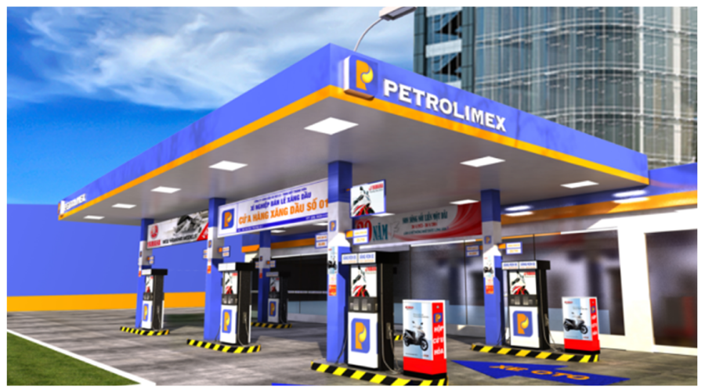

Slide 15
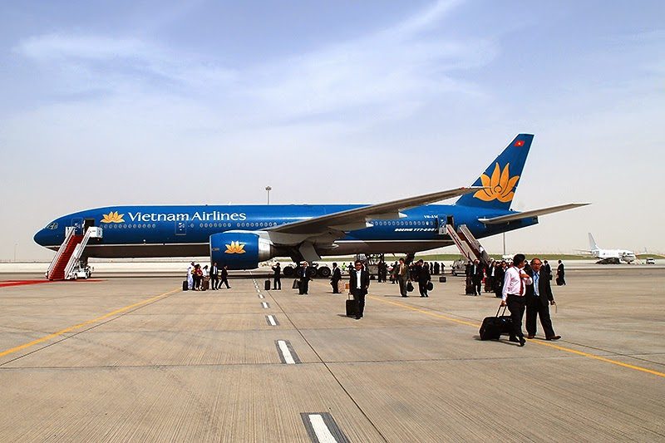

Slide 16
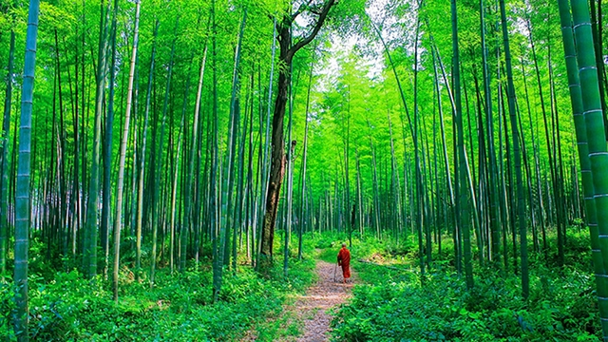

Slide 17
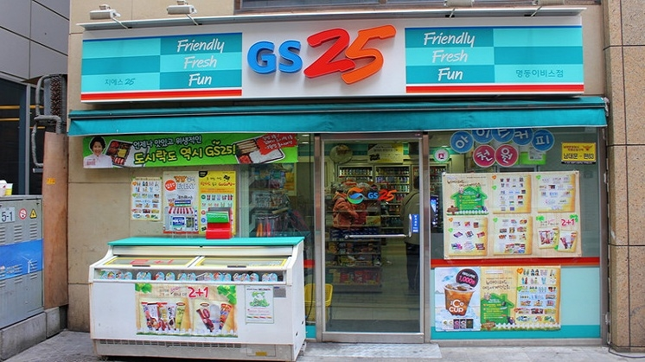

Slide 18
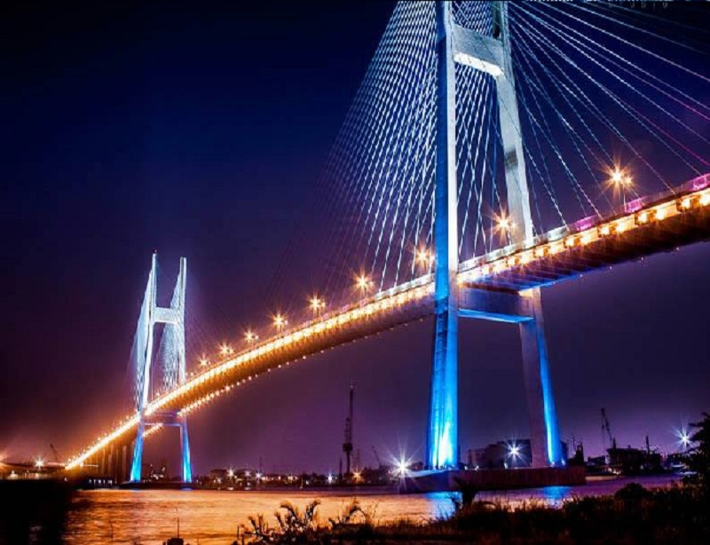

Slide 19
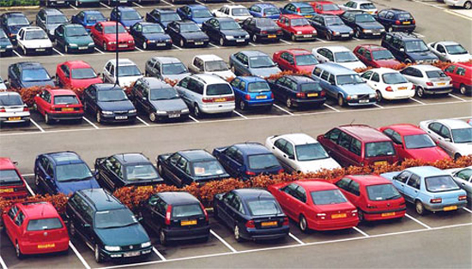

Slide 20
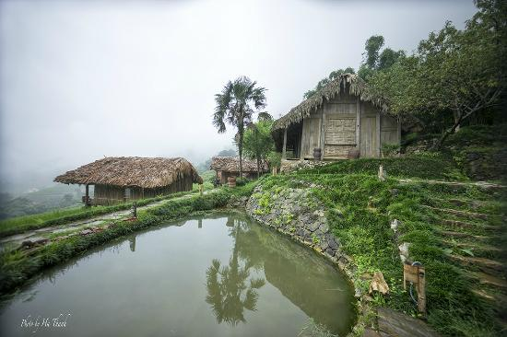
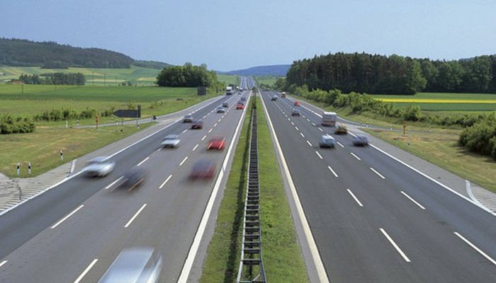
New words:
1. fuel (n)
→ nhiên liệu
2. pond (n)
→ ao nước
3. highway (n)
→ đường cao tốc

Slide 21
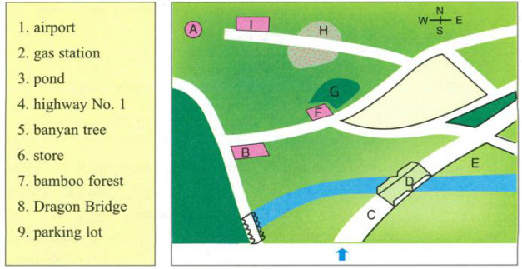
Guessing before listening
Where can you put these places on the map?
parking lot
parking lot
airport
gas station
pond
highway no.1
banyan tree
store
bamboo forest
Dragon Bridge
pond
highway no.1
Dragon Bridge

Slide 22
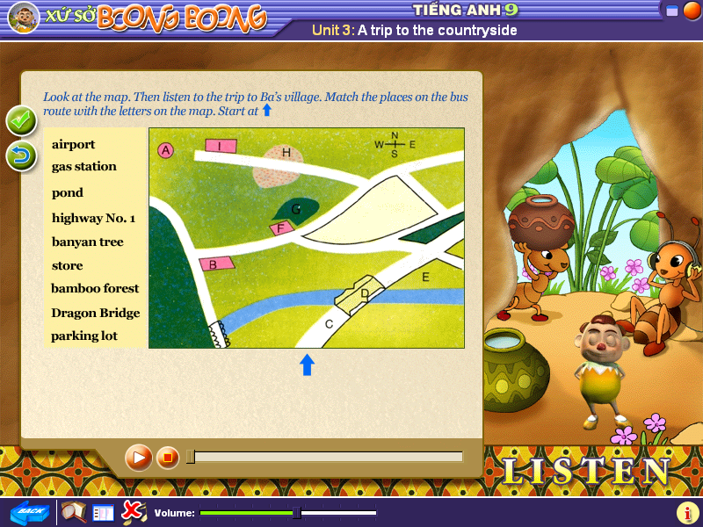


Slide 23
Listen and Matching:
Match the places on the bus route with the letters on the map
airport
gas station
pond
highway no.1
banyan tree
store
bamboo forest
Dragon Bridge
parking lot

Slide 24
III: Further practice
GAP-FILL
At
morning
(1)…………6.30 in the……….., the bus collected Ba and his family (3)……….. their home. (4)……. about 20 minutes on Highway No.1, the bus stopped at the(5) …………. to get some more fuel. Then, it turned left (6) …… a smaller road westward. After that, it turned left (7) ………. onto a road which went through a small (8)……...................... Finally, the bus dropped everyone off at the (9)…………………. ten meters (10)……………. a big old (11)………………... It parked there and waited for people to come back in the evening.
from
After
gas station
onto
again
bamboo forest
parking lot
from
banyan tree

Slide 25
Listen then correct the mistakes
The bus continued south on Highway Number 1.
=> The bus continued north on Highway Number 1.
It left the highway and turned left onto a small road eastward.
=> It left the highway and turned left onto a small road westward.
This road ran behind green paddy fields.
=> This road ran between green paddy fields.
The road ended before a big store behind a pond.
=> The road ended before a big store beside a pond.
The bus went in the right direction.
=> The bus went in the opposite direction.

Slide 26
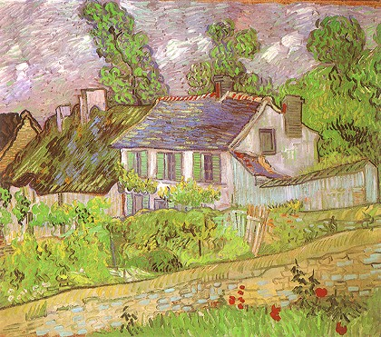
UNIT 3: A TRIP TO THE COUNTRYSIDE
HOMEWORK
Lesson 16: Speak ( P. 24 )
Use the information about Lan’s village:
Lan’s village is to the south of the city. It’s about 30 kilometers from the city. She can get there by bus . It takes her 1 hour to get there. People in her home village plant rice and vegetables . There is a river flowing across the village.
To talk about your home village, begin with:
My home village is to the west/south of the city. It’s not very far from here, about 15 km. I can get there by …
homework
Do Ex. 3, 4 ( P. 21 in workbook ).
- Write about your home village.
Tell your friend the story of the trip to Ba’s village.
Prepare for lesson 3: Read (p.25)

